Slide 1
Lecture 5: schedulIng and memory management
Prof Yotov
CS6233
Slides by Prof. Sandoval
Some slides derived from : Prof Dolan-Gavitt
Thanks !!
Notes:
It can be

Slide 2
scheduling
Notes:
Lect8 and Lect 9 from Brandon

Slide 3
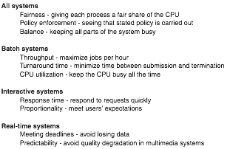
Scheduler Goals
Notes:
Two types of schedling algos:
Batch
Interactive.
Fairness: should be fail
Policy: polciy such that it should have to wait more than x minutes
Balance: some things are active and some are not.
Batch you maximize how many jobs you can get done in an hour
If you get the maximum people happy to so that maybe most pople get a quick turnaround time
Interactive systems:
Proportionality: things that users think should be simple shouldn’t take too much time.
Complicated things migth be able to take a little longer

Slide 4
Metrics
Throughput – jobs completed / time interval
Turnaround – average time between when a job is submitted and when it completes
Response time – time between when a user issues a command and gets the result
Notes:
You can optimze for one but the other’s suffer.
So it’s all a tradeoff

Slide 5
Tradeoffs
Improving on one metric can hurt another
For example:
We want to improve throughput, so we decide to only schedule short jobs
But now longer jobs never get run, so their turnaround time is effectively infinite
Notes:
Extreme example.

Slide 6
Scheduling Algorithms

Slide 7
First Come First Served
Single queue of ready processes
The process at the head of the queue runs as long as it likes or until it blocks
After it runs, you add it to the back of the queue and let the next one in line run
Notes:
1960s style mainframe

Slide 8
FCFS
Very easy to program! Can just use a linked list.
But I/O may suffer
CPU-bound process can take up lots of time
But I/O bound process will have to block and then wait until it gets back to the head of the queue before it can issue another I/O
Notes:
One problem is that I/O may suffer.
It might starve I/O bound process
It’s unfair to processes that use lot of I/0

Slide 9
Analyzing First Come First Served
To measure turnaround time:
( Sum( Time_{(completed)} – Time_{(submitted)} ) ) / N

Slide 10

Analyzing First Come First Served
Turnaround time depends on order we pick jobs Assuming jobs arrive at time 0:
Turnaround time: (32 + 37 + 42) / 3 = 37 minutes
A (32 minutes)
B (5 minutes)
C (5 minutes)
Notes:
It can be slightly confusing.
Every job arrives at time 0 and completes at time 32
Write it on the board.

Slide 11
Analyzing First Come First Served
Turnaround time depends on order we pick jobs Assuming jobs arrive at time 0:
Turnaround time: (5 + 10 + 42) / 3 = 19 minutes
B (5 minutes)
C (5 minutes)
A (32 minutes)
Notes:
It can be slightly confusing.
Every job arrives at time 0 and completes at time 32
Write it on the board.

Slide 12
Shortest Job First
Batch, non-preemptive
Assumes we can predict how long each job will take to execute
Always picks the job with the shortest time to execute to run
Notes:
This work in the batch account job where the delta is not that big
So most jobs are going to be predictable
We will sort the jobs by how long they take to complete and then run them

Slide 13
Analyzing Shortest Job First
Using SJF provably minimizes turnaround time
To see why, consider scheduling 3 jobs with runtimes a, b, and c
Turnaround time = (a + (a + b) + (a + b + c)) / 3 = (3a + 2b + c) / 3
So to minimize turnaround time, we want a to be as small as possible (since it has the largest effect on the average)
Notes:
The intuitino behind it.
They are all available at time 0
Expand this out using induction

Slide 14

Counterexample
The optimality proof only applies when all jobs are available at time 0
Suppose we have instead: Then turnaround time is (2 + 6 + (7 - 3) + (8 - 3) + (9 - 3)) / 5 = 4.6
But if we run them in the order B, C, D, E, A, time is: (4 + (5 - 3) + (6 - 3) + (7 - 3) + 9) / 5 = 4.4
Available at minute 0
Available at minute 3
A (2 minutes)
B (4 minutes)
C (1 minute)
D (1 minute)
E (1 minute)
Notes:
We can’t see the future
So this is just a counterexample to why the optimality proof doesn’t apply if they are not at time 0
Subtract 3 because they were just submitted at time 3.
These are not super applicable to our current computer.
Most people don’t do this.
This applies to things like simulation jobs. Maybe a super cmputing cluster.

Slide 15
Interactive Scheduling
In an interactive system, scheduling algorithms are generally preemptive
Time is divided up into slices called quanta
Each process runs for 1 quantum and then the scheduler runs again
Notes:
The idea is that you can like we discussed, let them run after their quantum, but every quantum you make a decision.

Slide 16
Round Robin Scheduling
Again, simple algorithm
Run first process until its quantum is used up
Move that process to the end and run the next process until its quantum is used up
Simple, fair
Notes:
Interactive equivalent to FCFS
We saw this with xv6
So you have a list and run the first process until it’s quantum isused up, move that process to the end…

Slide 17
Design Considerations with Round Robin
The length of the quantum is typically determined by a hardware timer interval
This is generally configurable
So: how long should we make a quantum?
Notes:
As you might remember, You have a fixed cost when you switch between processes.
So that’s why it’s interesting to figure out the optimal size.

Slide 18
Design Considerations with Round Robin
Context switching itself takes some amount of time (swap out CPU registers, change address space)
If context switching takes 1ms, and the quantum is 4ms, then we spend 20% of the time just switching between processes
But if we set the quantum too large (say, 100ms), then it could take up to 5 seconds before a process gets to run on a system with 50 active processes
Tuning this is a balancing act. Values around 10-50ms are common (xv6 uses a 10ms quantum)
Notes:
Real Os 10 – 15 ms are common
Reasonable between context switching.

Slide 19
Priorities
Round robin scheduling assumes that every process has the same priority
In reality, we may always want some processes to get scheduled before others
Possible policies:
Safety-critical code should run first
Users who pay more should get higher priority
Interactive processes should get priority over daemons
Notes:
Nuclear reactor example
Amazon might want paid paying more

Slide 20
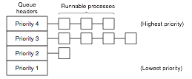
Priority Scheduling
Notes:
Run all the ones in the highest priority
When all the high priority jobs are sleeping or doing I/O
There is some problem with this?
Lower priority ? Starvation..

Slide 21
Dynamic Priority
We can also adjust the priority of processes dynamically
One nice way to use this is to dynamically give I/O bound processes more chances to run
We can set the priority as a function of the fraction of the last quantum the process actually used: priority = 1 / f f = fraction of quantum used
This would give higher priority to processes that used a smaller fraction of their quantum – i.e., processes that waited for I/O
Notes:
Inverse of the amount of quantum used last time
1/10 you get the higher priority
You get more chances to run because there is an expectation that you won’t use your quantum so you can do more I/0

Slide 22
Shortest Process Next
Latency in an interactive system is analogous to turnaround time in a batch system
Unfortunately in an interactive system we don't necessarily know how long a command will take
But we can make estimates, and then update our estimates over time with real data
Notes:
Very simple learning algorithm
Take some initial estimate: T(zero) I’m gonna assume 5 ms.
You are gonna want to update over time but don’t keep your estimates forever

Slide 23
Process Aging
Set some initial estimate T0
Run the process and measure to get T1
Fix a, the aging parameter; 0 ≤ a ≤ 1
After running a process, update the estimate as: Ti = aTi-1 + (1-a)Ti-2

Slide 24
Process Aging
Remember:
Ti = aTi-1 + (1-a)Ti-2
So with a = 1/2, the estimates become:
T0,
T0/2 + T1/2,
T0/4 + T1/4 + T2/2,
T0/8 + T1/8 + T2/4 + T3/2
Over time, our initial estimate is weighted less and less and more recent events have greater weight
Notes:
½ is easy and fast to implement

Slide 25
Guaranteed Scheduling
Guarantee to each of n processes that they will get 1/n about 1/n of the CPU
As processes run, keep track of how much CPU time they have actually used
Now we can schedule processes based on how "unfair" we have been to them up to this point
Easy to say, hard to implement!

Slide 26
Lottery Scheduling
We can get a probabilistic version of guaranteed scheduling that is much easier to implement
Give each process a fixed number of lottery tickets
When it comes time to schedule, pick a random number between 1 and the number of tickets
Schedule the process that won the lottery
Notes:
If you take advantage of randomness…
You give each process

Slide 27
Lottery Scheduling
We can give each process a proportion of the CPU by just giving it that proportion of the tickets
We can also guarantee that every process eventually gets to run as long as it gets at least one ticket
It's not a true guarantee, however – only a probabilistic one
Notes:
It’s not a true guarnatee, you might get unlucky

Slide 28
Lottery Scheduling
“All processes are equal, but some are more equal” – George Orwell

Slide 29
Implementing Lottery Scheduling
Take our existing process control block (PCB) data structure and augment it with a num_tickets field
At scheduling time:
Generate a random ticket number winner
Loop over processes, keeping a counter
If counter ≥ winner then pick that process
Otherwise, add the process's tickets to counter and continue

Slide 30
Lottery Scheduling
60
15
75
5

Slide 31
Lottery Scheduling
Winner: 83
60
15
75
5

Slide 32
Lottery Scheduling
Winner: 83
60
15
75
5
Counter: 0

Slide 33
Lottery Scheduling
Winner: 83
60
15
75
5
Counter: 60

Slide 34
Lottery Scheduling
Winner: 83
60
15
75
5
Counter: 75

Slide 35
Lottery Scheduling
Winner: 83
60
15
75
5
Counter: 150

Slide 36
Lottery Scheduling
Winner: 83
60
15
75
5
Counter: 150
Notes:
This doesn’t take too much to implement.
5 lines of code or so.
Homework 3 is gonna have you do this.

Slide 37
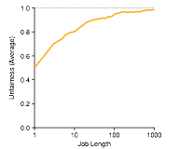
Analyzing Lottery Scheduling
Notes:
As the length of the job gets longer it get more and more fair.
Over time it converges on being fair.
We are making a simplifying assumption
You have n procesess each one gets 1/n the cpu.
You start them all the same time they all finish at the same time.

Slide 38
Real-Time Scheduling
Real-time operating systems receive events and must respond to them within a fixed amount of time
Multimedia systems – if you don't process audio/video fast enough, you get pauses & skips
Control systems – autopilot, industrial manufacturing control
Hard real time vs soft real time – how bad is it to miss a deadline?
Notes:
Industrial settings
Chemical plant
Manufacturing system
Also audio and video players.
Hard vs Soft? How bad is it.
Hard Landing gear on the plane.
Soft real time, watching movie, if you have one skip, people will forgive you and no one is gonna die.

Slide 39

Is it Schedulable?
Events in real-time systems can be periodic or aperiodic
If we have m periodic events and event i occurs with period Pi and takes Ci time to process, we need
If this is satisfied we say the real-time system is schedulable
Notes:
This is whether you can do it in principle, not in practice.

Slide 40
threads

Slide 41
threads
In many operating systems, we can have multiple threads of execution inside a single process
As with processes, each thread has its own program counter & CPU state
Unlike processes, multiple threads within a process share their address space and memory
Notes:
Just like processes have their own CPU state and PC.

Slide 42
Threading Benefits
Same benefits as for processes – can have multiple things going on at once – but still share data easily
In particular, multiple threads are useful when there are multiple I/O tasks to be done
Can allow a single application to take advantage of multiple processors
Notes:
why?
Multiple I/O tasks related to the same process
Separate threads rendering, fetching data,
As opposed to download and then render
You can actually run truly simultaneously

Slide 43
Threading Benefits
Threads are more lightweight – faster to switch between threads than between processes
Example: in a web browser, can have threads for responding to user input, loading data from network, rendering HTML
Notes:
Switching between threads is really quick.
Just swap a handful of registers
No new address space
Switching threads is done in user space.
The part that is slow is switching address space.
Switching CPU states is faster.

Slide 44
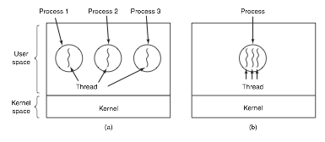

Slide 45
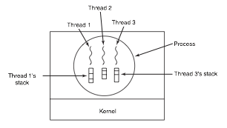
Notes:
Each one has its own CPU context
Which includes it’s stack area
They share the memory space

Slide 46
Threading – Cooperation
Unlike processes, no protection between threads
Thus, threads are assumed to always be mutually cooperating
Threads share:
Address space
Global variables
Open Files

Slide 47
Threading Model
Typically start with a single thread
API calls then allow:
Thread creation
Thread exit (without exiting the process)
Waiting for another thread to finish (join)
Giving up the CPU voluntarily (yield)

Slide 48
Threading Implementation: User Space
We can implement threading without any changes to the underlying operating system
Each process can maintain a table of threads, keeping track of its CPU context & stack
The process can implement a thread scheduler that chooses the next thread to run when one exits or yields
Notes:
This assumes that threads relinquish the CPU volutnaril

Slide 49
User Space Threading Downsides
Suppose we have a thread that wants to make a blocking system call (e.g., recv to wait for a network packet)
With user-space threading, we can't just make the call, or else all threads will stop (defeating the point of multithreading)
If the OS supports non-blocking versions of system calls, it's possible to work around this
Force the programmer to always use non-blocking versions
Write a wrapper library that converts blocking calls to their non-blocking versions and then yields to another thread
Notes:
doesn’t fly very well
Hard
Javascript people have written this but it happens.

Slide 50
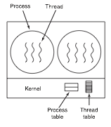
Kernel Threads
Much more common to implement threading in the kernel
Notes:
Lots of overhead

Slide 51
Kernel Threads
Now threading is handled by the OS scheduler
No different from switching between processes, but we don't need to change address space
Downside: switching between user and kernel mode still has some overhead, so it is inherently slower than user-space threading
Faster system call mechanisms like sysenter/sysexit are designed to mitigate this problem

Slide 52
Threading: Pitfalls
Global variables are shared between all threads
One thread's use of a global may interfere with another
Example:
The UNIX C library provides a global variable, errno, which holds the error code of the last API call
If two threads try to use the C library and check the status of errno, one may get incorrect results
Notes:
We’ll cover concurrency later in the semester

Slide 53
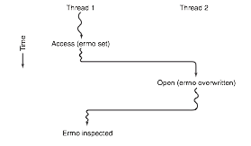
errno Conflict
Note: on modern UNIX systems (e.g. Linux) errno is actually replaced by a call to a function __errno_location() that is thread-safe

Slide 54
Thread-Local Storage
Instead of global variables, we can have an API that lets us have separate "globals" for each thread
Example – Windows API:
TlsAlloc() – sets up a thread-local storage area
TlsSetValue(TlsIndex, Value) – puts Value into the thread's local storage slot
TlsGetValue(TlsIndex, *Value) – retrieves Value from the thread's local storage

Slide 55
Thread-Local Storage
TLS can also be implemented as a compiler extension
In GCC, we can declare a variable as __thread int i;
At runtime, when we reference i, it will automatically retrieve the version for the current thread
Notes:
It’s transformed into the thread local storage version

Slide 56
Threading Takeaways
Having multiple threads can be extremely beneficial for responsiveness, taking advantage of multiple processors, etc.
Converting single-threaded applications or libraries to use multiple threads is not trivial
We will cover these issues in more detail when we talk about concurrency
Notes:
Very difficult to convert to multi threaded version.

Slide 57

xv6: State Transitions
ZOMBIE
5
RUNNING
SLEEPING
RUNNABLE
5. Process Exits

Slide 58
1. Process Blocks for Input
RUNNING
SLEEPING
Example: waiting for the user to type something
In console.c, consoleread calls sleep() to put any process waiting for keyboard input to sleep until a key is pressed

Slide 59
int
consoleread(struct inode *ip, char *dst, int n)
{
uint target;
int c;
iunlock(ip);
target = n;
acquire(&input.lock);
while(n > 0){
while(input.r == input.w){
if(proc->killed){
release(&input.lock);
ilock(ip);
return -1;
}
sleep(&input.r, &input.lock);
}

Slide 60
// Atomically release lock and sleep on chan.
// Reacquires lock when awakened.
void
sleep(void *chan, struct spinlock *lk)
{
[... locking code omitted ...]
// Go to sleep.
proc->chan = chan;
proc->state = SLEEPING;
sched();
// Tidy up.
proc->chan = 0;
[... code omitted ...]
}

Slide 61
2. Scheduler Picks Another Process
RUNNING
RUNNABLE
Example: time slice is up (timer interrupt fires)
In trap.c, the trap function will forcibly give up the CPU on a timer interrupt

Slide 62
Trap
void
trap(struct trapframe *tf)
{
[... other trap handling omitted ...]
// Force process to give up CPU on clock tick.
// If interrupts were on while locks held, would need to check nlock.
if(proc && proc->state == RUNNING && tf->trapno == T_IRQ0+IRQ_TIMER)
yield();
// Check if the process has been killed since we yielded
if(proc && proc->killed && (tf->cs&3) == DPL_USER)
exit();
}

Slide 63
Yielding
// Give up the CPU for one
// scheduling round.
void
yield(void)
{
acquire(&ptable.lock); //DOC: yieldlock
proc->state = RUNNABLE;
sched();
release(&ptable.lock);
}

Slide 64
3. Scheduler Picks This Process
RUNNABLE
RUNNING
Example: the main scheduler() function in proc.c

Slide 65
void
scheduler(void)
{
struct proc *p;
for(;;){
// Enable interrupts on this processor.
sti();
// Loop over process table looking for process to run.
acquire(&ptable.lock);
for(p = ptable.proc; p < &ptable.proc[NPROC]; p++){
if(p->state != RUNNABLE)
continue;
// Switch to chosen process. It is the process's job
// to release ptable.lock and then reacquire it
// before jumping back to us.
proc = p;
switchuvm(p);
p->state = RUNNING;
swtch(&cpu->scheduler, proc->context);
switchkvm();
// Process is done running for now.
// It should have changed its p->state before coming back.
proc = 0;
}
release(&ptable.lock);
}
}

Slide 66
4. Input Becomes Available
SLEEPING
RUNNABLE
Example: user presses a key
In trap.c, the interrupt handler recognizes that a keyboard interrupt has occurred and calls the keyboard handler, which calls the console handler
Console handler finally calls wakeup() to notify any processes waiting for keyboard input

Slide 67
trap.c
kbd.c
void
trap(struct trapframe *tf)
{
[...]
switch(tf->trapno){
[...]
case T_IRQ0 + IRQ_KBD:
kbdintr();
[...]
}
}
void
kbdintr(void)
{
consoleintr(kbdgetc);
}
console.c
void
consoleintr(int (*getc)(void))
{
[...]
if(c == '\n' || c == C('D') || input.e == input.r+INPUT_BUF){
input.w = input.e;
wakeup(&input.r);
}
[...]
}

Slide 68
proc.c
// Wake up all processes sleeping on chan.
// The ptable lock must be held.
static void
wakeup1(void *chan)
{
struct proc *p;
for(p = ptable.proc; p < &ptable.proc[NPROC]; p++)
if(p->state == SLEEPING && p->chan == chan)
p->state = RUNNABLE;
}
// Wake up all processes sleeping on chan.
void
wakeup(void *chan)
{
acquire(&ptable.lock);
wakeup1(chan);
release(&ptable.lock);
}

Slide 69
5. Process Exits
RUNNING
ZOMBIE
Happens at process exit (i.e. the exit() system call)
Process gets marked as a zombie, and anyone that might be waiting for its exit status gets woken up
Process doesn't actually get destroyed until someone calls wait()
If the parent isn't around to call wait(), the zombie gets reparented (assigned to init)

Slide 70
proc.c
// Exit the current process. Does not return.
// An exited process remains in the zombie state
// until its parent calls wait() to find out it exited.
void
exit(void)
{
struct proc *p;
[...]
// Parent might be sleeping in wait().
wakeup1(proc->parent);
// Pass abandoned children to init.
for(p = ptable.proc; p < &ptable.proc[NPROC]; p++){
if(p->parent == proc){
p->parent = initproc;
if(p->state == ZOMBIE)
wakeup1(initproc);
}
}
// Jump into the scheduler, never to return.
proc->state = ZOMBIE;
sched();
panic("zombie exit");
}

Slide 71
Who Cleans Up?
// Wait for a child process to exit and return its pid.
// Return -1 if this process has no children.
int
wait(void)
{
struct proc *p;
int havekids, pid;
acquire(&ptable.lock);
for(;;){
// Scan through table looking for zombie children.
havekids = 0;
for(p = ptable.proc; p < &ptable.proc[NPROC]; p++){
if(p->parent != proc)
continue;
havekids = 1;
if(p->state == ZOMBIE){
// Found one.
pid = p->pid;
kfree(p->kstack);
p->kstack = 0;
freevm(p->pgdir);
p->state = UNUSED;
p->pid = 0;
p->parent = 0;
p->name[0] = 0;
p->killed = 0;
release(&ptable.lock);
return pid;
}
}
[...]
// Wait for children to exit. (See wakeup1 call in proc_exit.)
sleep(proc, &ptable.lock); //DOC: wait-sleep
}
}

Slide 72
The Role of Init
Init is the first process created
It spawns the system shell (sh)
After starting the shell, sits in a loop calling wait() in case any zombies get assigned to it

Slide 73
init.c
int
main(void)
{
int pid, wpid;
[...]
for(;;){
[...]
while((wpid=wait()) >= 0 && wpid != pid)
printf(1, "zombie!\n");
}
}

Slide 74
Question
How can we create an orphan zombie that must be adopted by init?
Or, restated – how do we make init.c reach the printf that prints "zombie!" ?

Slide 75
zombie.c
// Create a zombie process that
// must be reparented at exit.
#include "types.h"
#include "stat.h"
#include "user.h"
int
main(void)
{
if(fork() > 0)
sleep(5); // Let child exit before parent.
exit();
}

Slide 76
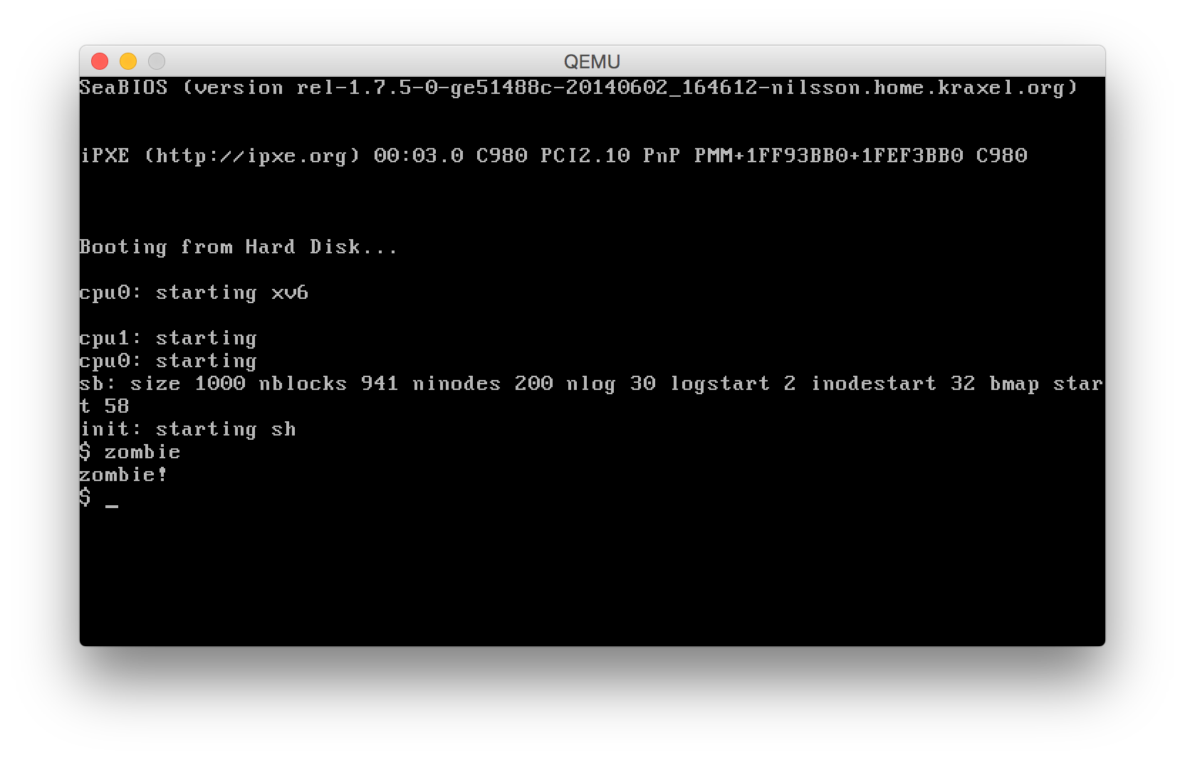

Slide 77
Memory management

Slide 78
Memory
RAM is one of the main resources managed by an operating system
RAM is volatile storage (does not persist across reboots)
The portion of the OS that allocates, frees, and tracks the usage of RAM is the memory manager
Notes:
Main memory:
Nanoseconds 15 – 100ns
3 tiers of memory:
External repositories: optical disks
Physical memory RAM pretty sizable
cache: super fast
Part of the concern of the OS is to balance what is sitting where.

Slide 79
In Ancient Times: No Abstraction
Early computers had no abstraction for memory
You ask for data at address 0x1234, you get the data stored at physical memory location 0x1234
This is often called the physical memory model because every address refers directly to a physical location in memory

Slide 80
Hello.asm
00007C00 BE167C mov si,0x7c16
00007C03 B400 mov ah,0x0
00007C05 B003 mov al,0x3
00007C07 CD10 int 0x10
00007C09 AC lodsb
00007C0A 84C0 test al,al
00007C0C 7406 jz 0x7c14
00007C0E B40E mov ah,0xe
00007C10 CD10 int 0x10
00007C12 EBF5 jmp short 0x7c09
00007C14 EBFE jmp short 0x7c14
00007C16 db "Hello, world", 0

Slide 81
Physical Memory Model Organization
Even with such a simple model there are still decisions to be made:
Where do we put the OS code?
Where do user programs go?
If there is code in ROM, where does it live?

Slide 82
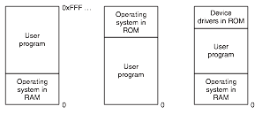
Notes:
Everyone has this in the BIOS.
This should be familiar to all of you.
User program lives in a bounded universe

Slide 83
No Abstraction: Downsides
Can't really have two independent programs running at the same time
Each would have to know explicitly about what memory was in use by the other – requiring cooperation
Note that it is possible to have multiple threads with flat memory
Threads always share the same address space anyway
Notes:
Don’t put your grubby hands on my X

Slide 84
Running Multiple Programs: The IBM 360
With specialized hardware, we can still have multiple programs running even with physical memory
Example: IBM 360 keeps a 4-bit descriptor for each 2KB block of memory, and a 4-bit identifier called the Program Status Word key
If a running program tries to touch memory whose descriptor doesn't match the PSW key
Notes:
What’s in the PCB of the processes that are not running.
When we put it back into running

Slide 85
Running Multiple Programs: The IBM 360
This does let you have multiple programs running at the same time
But: what happens if a program is loaded at a different address than the programmer expected?
Memory addresses are absolute, and so moving the program around means data & code will not be where the program expects to find it!

Slide 86
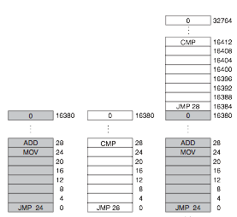
Running Multiple Programs: The IBM 360

Slide 87
Static Relocation
The workaround for this on the IBM 360 was to statically relocate the program when it was loaded
Maintain a list of all the places in the program where absolute addresses were used (relocations)
Modify them so that they match the program's new load address
This technique is actually alive and well today: shared libraries used by a program may have to be statically relocated before they are loaded

Slide 88
Memory Abstractions
The set of addresses a program can refer to is called its address space
We have seen that you can get into trouble if you all programs have the same address space
No protection from each other – errors in one program can cause damage to others
Programs must be written cooperatively, knowing about where others are located in memory
We would like to create an abstraction, so that each process has a private address space: make 0x1234 in Program A different from 0x1234 in Program B

Slide 89
Segmentation
An early way of providing separate address spaces was hardware segmentation
CPU gets extra base and limit registers
Each time a memory address is referenced, the CPU transparently adds the base to it and verifies that base+address ≤ limit
Downside: memory access becomes slightly slower because of the additional addition

Slide 90
Multiple Programs with Segmentation
mov al, [0x1234] jmp 0x100
data
0x5234
0x4100
Base = 0x4000
mov al, [0x1234] jmp 0x100
data
0x1234
0x100
Base = 0x0000
Notes:
Exactly how we do this, is different on each architecture.
Add the base on addresss
When you do a context switch is change the context of the base pointer

Slide 91
Segmentation in x86
We saw when we went over assembly that the x86 has 6 segment registers
This allows programs to have different segments for code, data, etc.
In protected mode, different segments can also have limits, protection

Slide 92
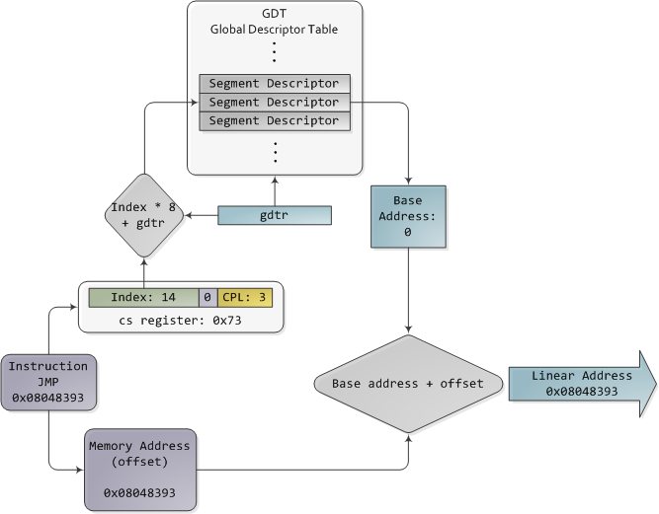
Image by Gustavo Duarte
http://duartes.org/gustavo/blog/post/memory-translation-and-segmentation/

Slide 93
Segmentation in 64-bit x86
On 64-bit x86, these have all been eliminated except FS and GS, and even there only base can be set (no limits or protection)
Why? Segments have fallen out of fashion in favor of virtual memory
Why keep FS and GS? Turns out OSes decided they wanted to use them for per-CPU data structures
For example, in Windows, FS+0x124 points to the thread running on the current processor

Slide 94
Swapping
We may not have enough RAM to keep all the programs we're running in memory at once
One strategy to get around this is to move programs from memory to disk when they're not being used (swapping)
Notes:
Sometimes the processes don’t have anything to do.
They are waiting for ??? I/O

Slide 95
Swapping
Operating System
Notes:
The blue here is free space.
The red is memory space occupied by the Operating sytems

Slide 96
Swapping
Program A
Operating System
Notes:
Here the OS, has loeade process A

Slide 97
Swapping
Program B
Program A
Operating System

Slide 98
Swapping
Program C
Program B
Program A
Operating System

Slide 99
Swapping
Program C
Program B
Operating System

Slide 100
Swapping
Program C
Operating System

Slide 101
Swapping
Program C
Program A
Operating System

Slide 102
Swapping
Program C
Program A
Program D
Operating System
Notes:
Now for some reason we have process D

Slide 103
Memory Compaction
As a consequence of swapping things in and out of memory, we might fragment memory
This could prevent us from loading a program even though we technically have enough memory for it
If necessary, we can shuffle things around so that we have one contiguous free space instead of multiple small "holes"
But: it may be slow! E.g. if it takes us 100 ns to read and then write 8 bytes of memory, ~107 seconds to move 8GB
Notes:
Why would we swap it out?
Because it blocked in I/O
To maximize the user of the CPU you want to have as many process in memo
External fragmentation

Slide 104
Compaction
Program C
Program A
Program D
Operating System

Slide 105
Growing Process Memory
In general a process will not start off with all the memory it will ever need
Function calls will cause it to use more of the stack
Dynamically allocated data structures will need space
So in this case we will need to grow the memory space allocated to the process

Slide 106
Growing Process Memory
If we allocate processes right next to each other, then we would have to move or swap them the first time the process grows
Instead, it makes more sense to start each process with room to grow

Slide 107
Growing Process Memory
Program C
Stack
Program A
Growth Area
Heap
Operating System

Slide 108
Keeping Track of Memory
To decide where to put programs, we need to know what memory is used/free
This is a job for the OS – maintain a data structure that it can use to know what's available
Two main structures used for this are bitmaps and lists

Slide 109
Memory Bitmap
Basic idea – allocate memory in chunks of size N (the allocation unit)
Store a sequence of bits where bit i says whether the ith chunk is free
The allocation unit size is yet another balancing act:
Large unit sizes mean fewer bits are needed to describe memory, but may waste memory if process is not exact multiple of N

Slide 110

Bitmaps
0
N
2N
3N
4N
6N
0
1
0
1
1
0
Suppose N = 8 bytes Then tracking 48 bytes of memory takes only 6 bits

Slide 111
Allocating/Freeing Memory
To mark space as free, just set the right bits to 0
To find space for a new process K units long, we need to search for a consecutive string of K zeroes
This could be very slow, since most CPUs deal in units of multiple bytes, not bits, and the string of 0s could straddle a byte/word boundary

Slide 112
List-Based Memory Tracking
Keep a linked list describing free and allocated regions
P 0x18 22
H 0x50 10
P 0x90 60
"Process"
vs "Hole"
Start
Address
Length

Slide 113
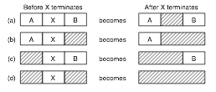
Freeing Memory

Slide 114
Finding Free Memory
Many strategies to find the right place to allocate a process that needs space:
First fit – just traverse the list and pick the first free range large enough
Best fit – traverse the list and pick the smallest big-enough free range
Slower and actually wastes more memory than first fit
Quick fit – keep separate lists for commonly needed sizes
Fast to allocate, but much slower to deallocate – hard to merge adjacent free ranges

Slide 115
Optimizations
Keep a separate freelist of just the unallocated regions
One nice trick is that we can actually store the list entries in the unallocated spaces themselves!
Keep the lists sorted by address, so it's easier to merge free regions later
Keep the lists sorted by size, so we don't have to search the entire list for the smallest

Slide 116
Memory Management in xv6
As in many things, the xv6 memory manager is designed to be simple rather than efficient
The basic structure is a simple singly-linked free list where each entry is the same size (4096 bytes, the default page size)
Note: for now we are just talking about how xv6 manages physical memory – the list of what's free and what's not
struct run {
struct run *next;
};

Slide 117
Initialization
When xv6 starts, it goes through and adds all available memory to the free list
int
main(void)
{
...
kinit2(P2V(4*1024*1024), P2V(PHYSTOP));
...
}

Slide 118
Freeing Each Page
void
kinit2(void *vstart, void *vend)
{
freerange(vstart, vend);
}
void
freerange(void *vstart, void *vend)
{
char *p;
p = (char*)PGROUNDUP((uint)vstart);
for(; p + PGSIZE <= (char*)vend; p += PGSIZE)
kfree(p);
}

Slide 119
kfree
void
kfree(char *v)
{
struct run *r;
if((uint)v % PGSIZE || v < end || v2p(v) >= PHYSTOP)
panic("kfree");
// Fill with junk to catch dangling refs.
memset(v, 1, PGSIZE);
r = (struct run*)v;
r->next = kmem.freelist;
kmem.freelist = r;
}
Notes:
Checks
PGSIZE Boundary
PHYSTOP -> physical stop
Memset (‘BADF00D’)
What’s happening here? In the last 3 lines.
No overhead.
Cast the pointer to the page then
Insert head, no overhead.
### Question
global

Slide 120
kalloc
char*
kalloc(void)
{
struct run *r;
r = kmem.freelist;
if(r)
kmem.freelist = r->next;
return (char*)r;
}
Notes:
Make it point to the second pointer

Slide 121
xv6 Allocation
kmem.freelist
0x1000
0x2000
0x3000
0x4000
0x5000

Slide 122
xv6 Freeing
kmem.freelist
0x1000
0x2000
0x3000
0x4000
0x5000

Slide 123
But Wait...
In our example of freeing memory, we ended up with a free list that did not contain pages in order
If kalloc() is called twice, it will hand out 0x5000 and then 0x1000
But user programs will probably want contiguous memory chunks larger than 4096 bytes
The answer is that user programs never see the addresses used by the memory manager
Virtual memory is used to map contiguous virtual addresses to a discontiguous set of physical pages

